Slide 1



Prime video
View in Power BI
Last data refresh:
6/14/2024 4:16:39 PM UTC
Downloaded at:
6/14/2024 4:17:24 PM UTC

Slide 2
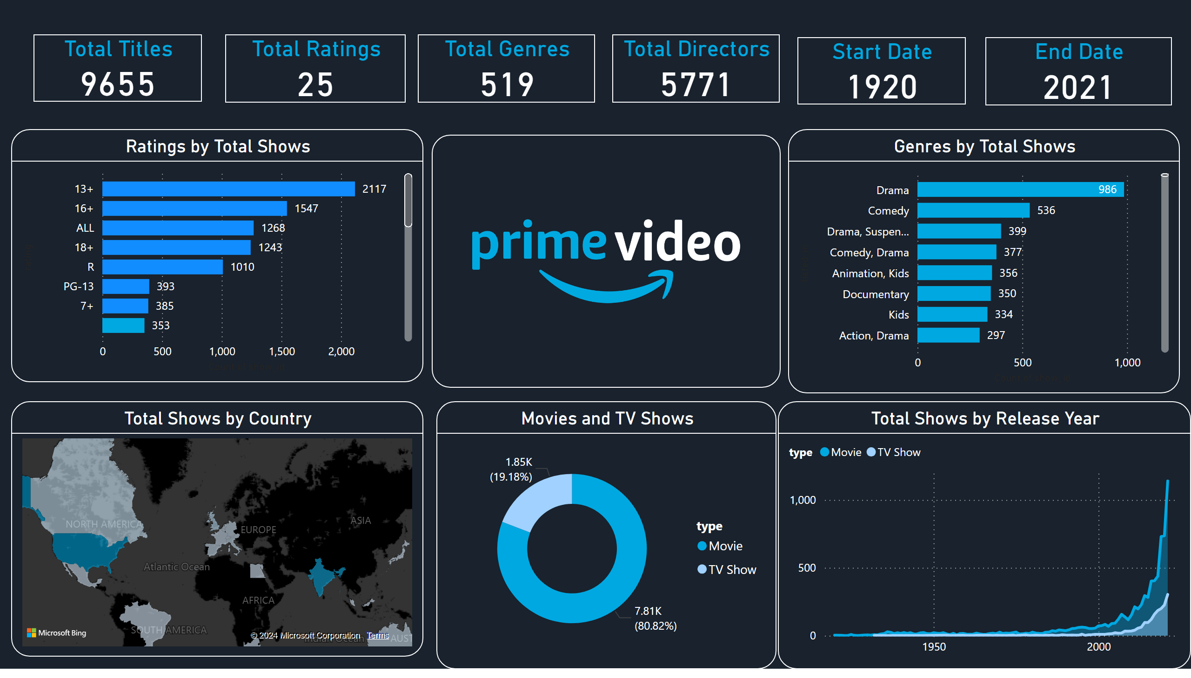
Page 1
Notes:
Total Shows by Country
No alt text provided
Movies and TV Shows
No alt text provided
Total Shows by Release Year
No alt text provided
image
No alt text provided
Ratings by Total Shows
No alt text provided
Genres by Total Shows
No alt text provided
Total Titles
No alt text provided
Total Ratings
No alt text provided
Start Date
No alt text provided
End Date
No alt text provided
Total Genres
No alt text provided
Total Directors
No alt text provided

